Slide 1
IT694 Computer Networks
Week4 – HTTP_II

Slide 2

Socket programming
goal: learn how to build client/server applications that communicate using sockets
socket: door between application process and end-end-transport protocol
application
socket
application
controlled by
app developer
process
process
transport
transport
network
network
controlled
by OS
link
Internet
link
physical
physical

Slide 3
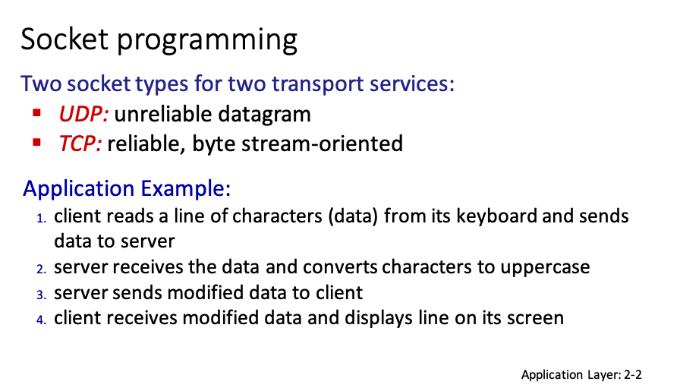

Slide 4
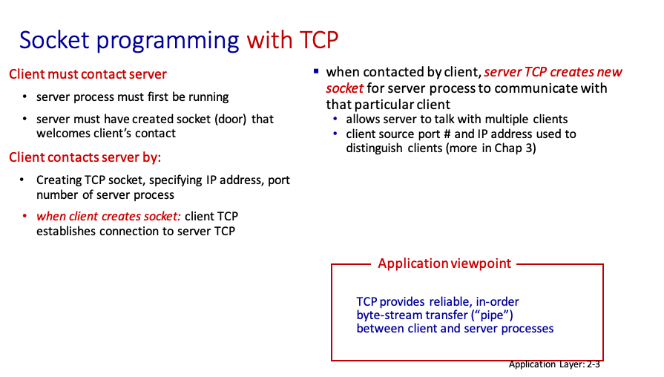
Ports 0-1023 Well known ports
Ports 1023-49151 Registered Ports
Ports 49152-65355 Private ports

Slide 5
Example app: TCP client
Python TCPClient
from socket import *
serverName = ’servername’
serverPort = 12000
clientSocket = socket(AF_INET, SOCK_STREAM)
clientSocket.connect((serverName,serverPort))
sentence = raw_input(‘Input lowercase sentence:’)
clientSocket.send(sentence.encode())
modifiedSentence = clientSocket.recv(1024)
print (‘From Server:’, modifiedSentence.decode())
clientSocket.close()
create TCP socket for server, remote port 12000
No need to attach server name, port

Slide 6
Example app: TCP server
Python TCPServer
from socket import *
serverPort = 12000
serverSocket = socket(AF_INET,SOCK_STREAM)
serverSocket.bind((‘’,serverPort))
serverSocket.listen(1)
print ‘The server is ready to receive’
while True:
connectionSocket, addr = serverSocket.accept()
sentence = connectionSocket.recv(1024).decode()
capitalizedSentence = sentence.upper()
connectionSocket.send(capitalizedSentence.
encode())
connectionSocket.close()
create TCP welcoming
socket
server begins listening for incoming TCP requests
loop forever
server waits on accept()
for incoming requests, new socket created on return
read bytes from socket (but not address as in UDP)
close connection to this client (but not welcoming socket)

Slide 7
HTTP is STATELESS

Slide 8

Maintaining user/server state: cookies
Recall: HTTP GET/response interaction is stateless
no notion of multi-step exchanges of HTTP messages to complete a Web “transaction”
no need for client/server to track “state” of multi-step exchange
all HTTP requests are independent of each other
no need for client/server to “recover” from a partially-completed-but-never-completely-completed transaction
a stateful protocol: client makes two changes to X, or none at all
X
lock data record X
X
OK
update X X’
X’
OK
t’
update X X’’
OK
X’’
unlock X
OK
X’’
time
time
Q: what happens if network connection or client crashes at t’ ?
Notes:
t’

Slide 9
Maintaining user/server state: cookies
Web sites and client browser use cookies to maintain some state between transactions
four components:
1) cookie header line of HTTP response message
2) cookie header line in next HTTP request message
3) cookie file kept on user’s host, managed by user’s browser
4) back-end database at Web site
Example:
Susan uses browser on laptop, visits specific e-commerce site for first time
when initial HTTP requests arrives at site, site creates:
unique ID (aka “cookie”)
entry in backend database for ID
subsequent HTTP requests from Susan to this site will contain cookie ID value, allowing site to “identify” Susan
Notes:
t’

Slide 10
Maintaining user/server state: cookies
client
Amazon server
ebay 8734
usual HTTP request msg
Amazon server
creates ID
1678 for user
cookie file
usual HTTP response
set-cookie: 1678
backend
database
create
entry
ebay 8734
amazon 1678
usual HTTP request msg
cookie: 1678
cookie-
specific
action
access
usual HTTP response msg
one week later:
access
ebay 8734
amazon 1678
usual HTTP request msg
cookie: 1678
cookie-
specific
action
usual HTTP response msg
time
time
Notes:
t’

Slide 11
HTTP cookies: comments
aside
What cookies can be used for:
authorization
shopping carts
recommendations
user session state (Web e-mail)
cookies and privacy:
cookies permit sites to learn a lot about you on their site.
third party persistent cookies (tracking cookies) allow common identity (cookie value) to be tracked across multiple web sites
Challenge: How to keep state?
at protocol endpoints: maintain state at sender/receiver over multiple transactions
in messages: cookies in HTTP messages carry state
Notes:
t’

Slide 12
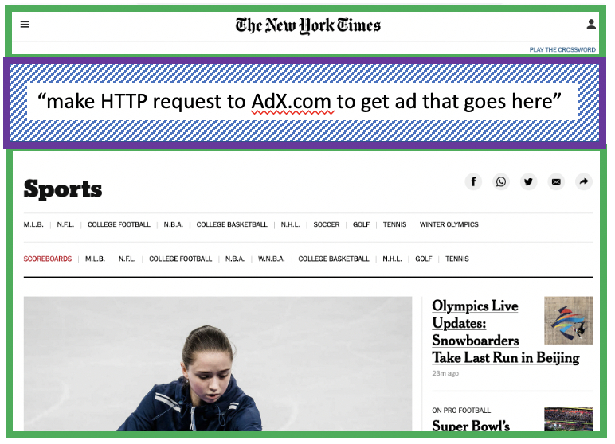
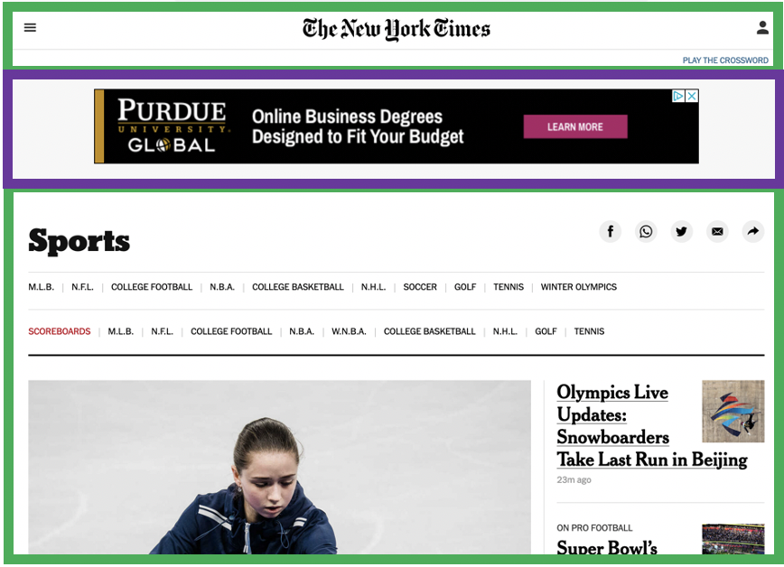


Example: displaying a NY Times web page
1
GET base html file from nytimes.com
2
fetch ad from AdX.com
nytimes.com
4
5
HTTP GET
1
2
HTTP reply
7
display composed page
3
4
6
5
NY times page with embedded ad displayed
AdX.com

Slide 13
Cookies: tracking a user’s browsing behavior
1634: sports, 2/15/22
nytimes.com (sports)
“first party” cookie – from website you chose to visit (provides base html file)
HTTP
GET
HTTP reply
Set cookie: 1634
HTTP GET
Referrer: NY Times Sports
4
5
7493: NY Times sports, 2/15/22
“third party” cookie – from website you did not choose to visit
HTTP reply
NY Times: 1634
Set cookie: 7493
AdX.com
AdX: 7493

Slide 14
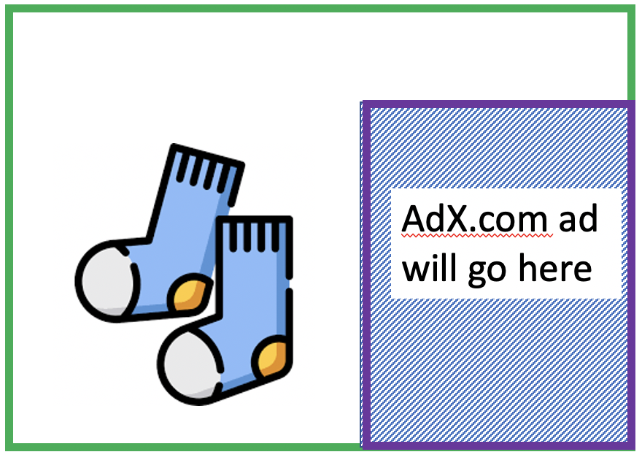
Cookies: tracking a user’s browsing behavior
1634: sports, 2/15/22
nytimes.com
AdX:
tracks my web browsing over sites with AdX ads
can return targeted ads based on browsing history
socks.com
HTTP reply
2
HTTP GET
1
HTTP GET
Referrer: socks.com, cookie: 7493
4
7493: NY Times sports, 2/15/22
5
7493: socks.com, 2/16/22
HTTP reply
NY Times: 1634
Set cookie: 7493
AdX.com
AdX: 7493

Slide 15

Cookies: tracking a user’s browsing behavior (one day later)
1634: sports, 2/15/22
1634: arts, 2/17/22
nytimes.com (arts)
socks.com
HTTP
GET
HTTP reply
cookie: 1634
Set cookie: 1634
HTTP GET
Referrer: nytimes.com, cookie: 7493
4
7493: NY Times sports, 2/15/22
5
7493: socks.com, 2/16/22
HTTP reply
7493: NY Times arts, 2/15/22
NY Times: 1634
Set cookie: 7493
AdX.com
AdX: 7493
Returned ad for socks!

Slide 16
Cookies: tracking a user’s browsing behavior
Cookies can be used to TRACK:
user behavior on a given website (first party cookies)
user behavior across multiple websites (third party cookies) without user ever choosing to visit tracker site (!)
tracking may be invisible to user:
rather than displayed ad triggering HTTP GET to tracker, could be an invisible link
third party tracking via cookies:
disabled by default in Firefox, Safari browsers

